Slide 1

Scientific Team Project: COVID-19 prediction on Chest X-Rays using Interpretable Machine Learning
Supervised by :
M.Sc. Uli Niemann Dr.-Ing. Monique Meuschke
Jalaj Vora [221510]
Subhajit Mondal [229590]
Subhankar Patra [229798]
Shivam Singh [229819]
03/09/2020

Slide 2
Content
Introduction, Background and Motivation
Problem Statement
State-of-the-art Literature Review
Previous Implementation
New Approach
Evaluation
Project Timeline (tentative)
References
03/09/2020

Slide 3
Introduction, Background and Motivation
The COVID-19 or the SARS-CoV-2 originated from the district of Wuhan, China has transpired to be a pandemic worldwide [1].
Due to shortage and limited efficiency of testing mechanism through RT-PCR test kits [2], it motivated the possibility of diagnosing patient being COVID-19 positive or negative based on Chest X-Rays (CXRs) and CT-Scans.
This is also a highly active topic among artificial intelligence community and this motivated to involve Machine Learning and Computer Vision methodologies in application.
03/09/2020
3

Slide 4
Problem Statement
Our research experiment, tries to predict COVID-19 on CXRs with Interpretable Machine Learning Models and tries to explain the predictions.
How well could classifiers perform on Chest X-Rays?
Although state-of-the-art approaches extensively works with Neural Networks (Black-Box Model) to classify, Can simple and intrinsically explainable classifiers achieve a base Accuracy, F1-Score and AUC similar to state-of-the-art using CXR?
Can we come up with explanation of our model’s decision and prediction?
We aim to build a pipeline that on given CXRs predicts whether the image is a COVID-19 +or- based on 14 radiological features [3 , 4] and explains it based on it’s contribution to prediction.
03/09/2020

Slide 5
State-of-the-art literature review
Reference | Image Type | Machine Learning Techniques Used
Brunese, Luca, et al. | CXRs | VGG16, GradCam
Wang, Linda, et al. | CXRs | COVIDNet, VGG19, ResNet15
Zhang, Jianpeng, et al. | CXRs | DeepCNN, Anomaly Detection
Wu, Yu-Huan, et al. | CT | VGG16, Unet, DSS, EGNet, PoolNet
Kassani, Sara Hosseinzadeh, et al. | CXRs and CT | CNN Deep Features with Decision Tree, Random forests, XGBoost, AdaBoost, Bagging Classifier, LightGBM
Pereira et al. | CXRs | Multi-class classification using k-Nearest Neighbots (kNN); Support Vectors Machine (SVM); Multilayer Perceptrons (MLP); Dicision Trees (DT); and Random Forests (RF)
Chatterjee, Soumick, et al. | CXRs and CT | Techniques Surveyed: ResNet18, ResNet34, InceptionV3, InceptionResNetV2, DenseNet161
03/09/2020
Table 1. State-of-the-art literature-review: Similar approaches

Slide 6
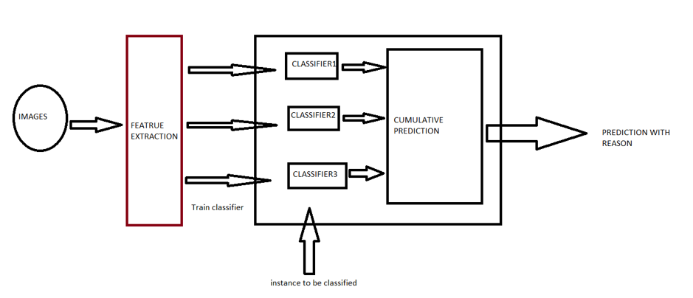
Previous Approach : Pipeline
03/09/2020
Figure 1 Source: https://jalajvora.github.io/COVID-19-predictions-on-Chest-X-Rays-using-Interpretable-Machine-Learning/

Slide 7
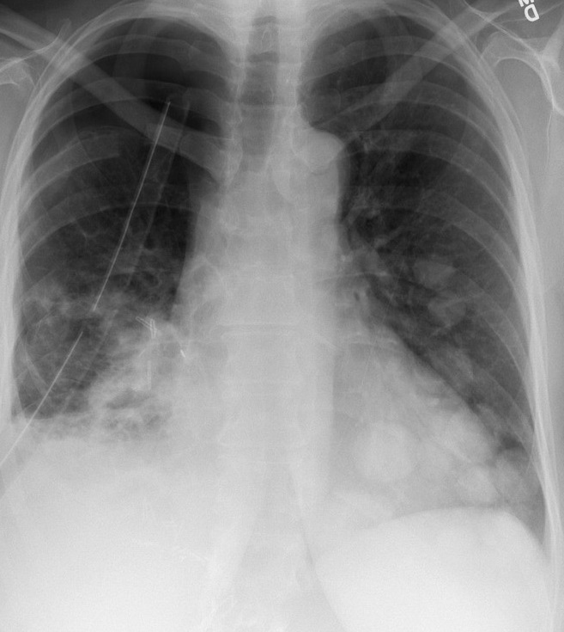
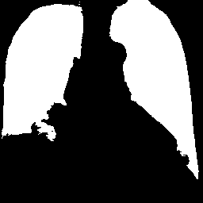
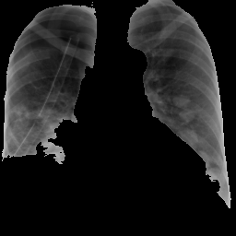
Previous Approach: Pre-processing
Region of Interest: Masking and Segmentation of Lungs
03/09/2020
Figure 2 Source: https://jalajvora.github.io/COVID-19-predictions-on-Chest-X-Rays-using-Interpretable-Machine-Learning/

Slide 8
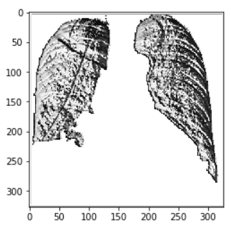
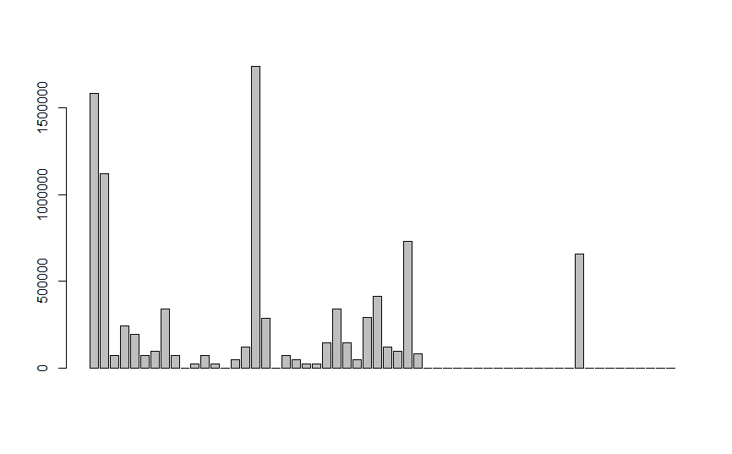
Feature Extraction: Local Binary Patterns
X-Ray Image
LBP Image
LBP Histogram
03/09/2020
Figure 3 Source: https://jalajvora.github.io/COVID-19-predictions-on-Chest-X-Rays-using-Interpretable-Machine-Learning/

Slide 9
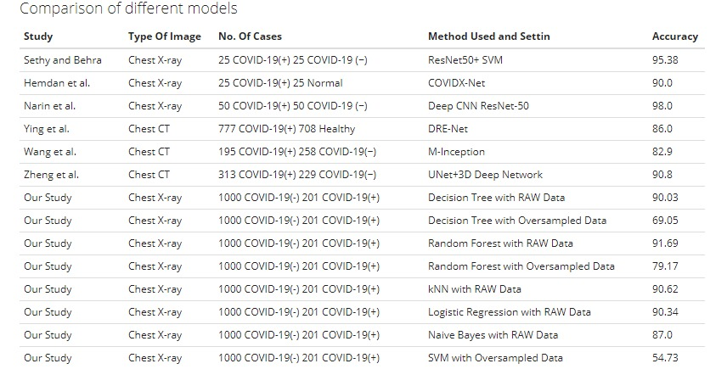
Previous Approach: Benchmark Comparison
03/09/2020
Figure 4 Source: https://jalajvora.github.io/COVID-19-predictions-on-Chest-X-Rays-using-Interpretable-Machine-Learning/

Slide 10
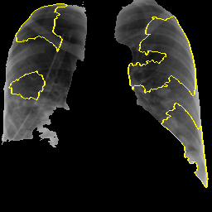
Previous Approach: Explanation using LIME
03/09/2020
Figure 5 Source: https://jalajvora.github.io/COVID-19-predictions-on-Chest-X-Rays-using-Interpretable-Machine-Learning/

Slide 11
New Approach
Research Questions:
With our old approach and similar approaches with state-of-the-art methods used as baseline, could we achieve a similar or better performance?
Interpretability study based on the SHAP approach and could we make it more applicable?
03/09/2020

Slide 12
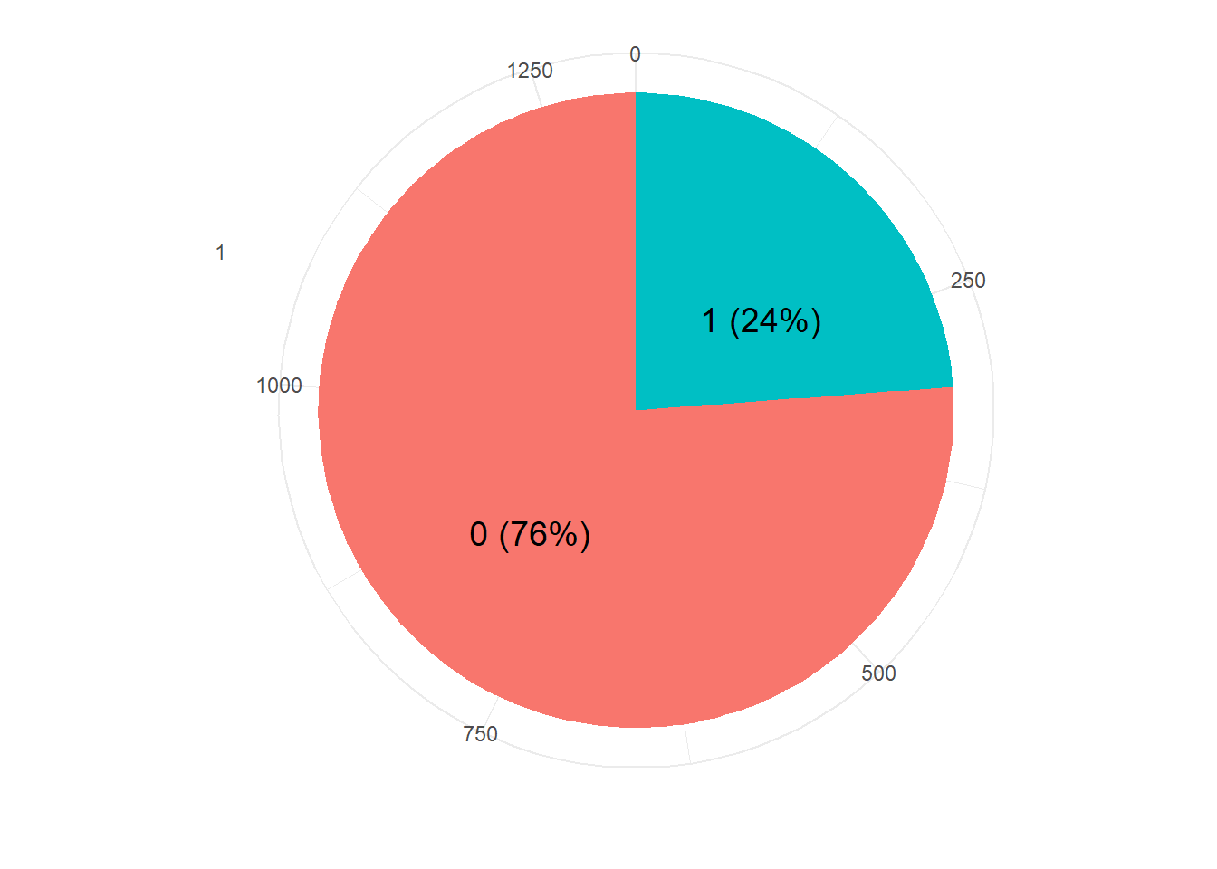
New Approach: Dataset
Our Dataset consists of 1000 COVID negatives and 313 COVID positives
03/09/2020
Figure 6 Source: https://jalajvora.github.io/COVID-19-predictions-on-Chest-X-Rays-using-Interpretable-Machine-Learning/

Slide 13
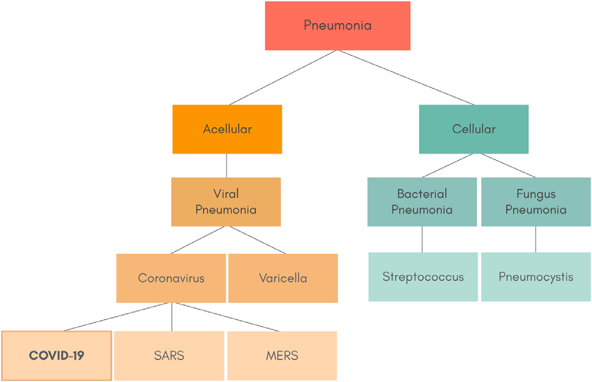
New Approach: Assumption
03/09/2020
Figure 7 Source: Peirara et. Al. [20]

Slide 14
New Approach: Radiological Features
These 14 radiological features are namely:
Atelectasis
Cardiomegaly
Consolidation
Edema
Effusion
Emphysema
Fibrosis
Hernia
Infiltration
Mass
Nodule
Pleural Thickening
Pneumonia
Pneumothorax
03/09/2020
14

Slide 15
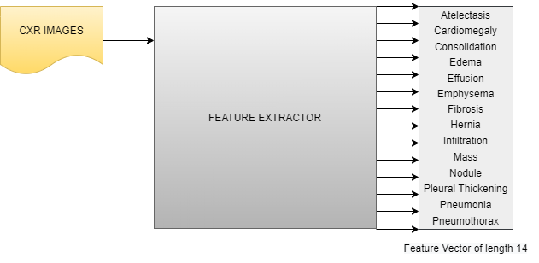
New Approach: Pipeline
03/09/2020

Slide 16
New Approach: State-of-the-art literature review - Feature Extraction
Reference | Image Type | Machine Learning Techniques Used
Nanni et al. | Neonatal facial, fluorescence microscope and smear cells images | LBP, LPQ, EQP, LTP, EBP, ILBP CSLBP and SVM
Parveen and Sthik | CXR | DWT, WFT, WPT and fuzzy C-means clustering
Scalco and Rizzi | CT, PET and MR | Grey-level histogram, GLCM, NGTDM, GLRLM and GLSZM
Zhou et al. | CT | YOLOv3, VGGNet and AlexNet
Narin et al. | CT | ResNet50, InceptionV3 and Inception-ResNetV2
Wang and Wong | CXR | COVID-Net a deep neural network created to detect NCP
Khan et al. | CXR | CoroNet a CNN created to detect NCP
Ozturk et al. | CXR | DarkNet and YOLO
03/09/2020
Table 2 State-of-the-art-literature-review: Feature Extraction

Slide 17
New Approach: Feature Extraction - Observations
More emphasis on automatic learning of features represented as features via hidden layer representation (Narin et. al.)
In case of handcrafted features, (for example used in Nanni et. al. ) more than one kind of descriptor is used with core aim of classification (and Not Explanation).
Radiological feature extraction and usage of such explicitly for learning is rarely studied in the community. The added advantage is that, the same helps in explanation to medical domain personnel.
03/09/2020

Slide 18
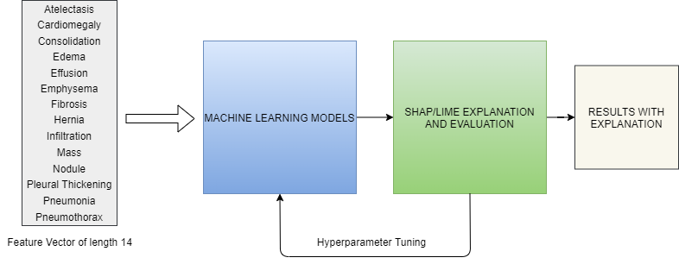
New Approach: Architecture
03/09/2020

Slide 19
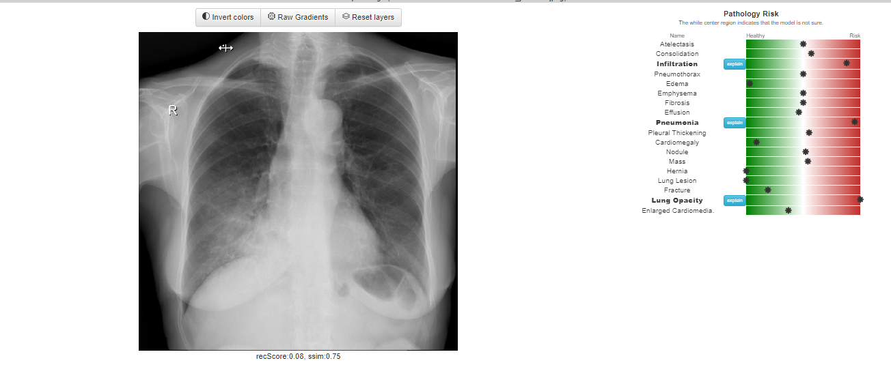
New Approach: UI/UX Design (tentative)
03/09/2020
Figure 7 Source: https://mlmed.org/tools/xray/

Slide 20
Evaluation
Factors based on which performance of models would be determined:
F1-Score
AUC/ROC
Accuracy
03/09/2020

Slide 21
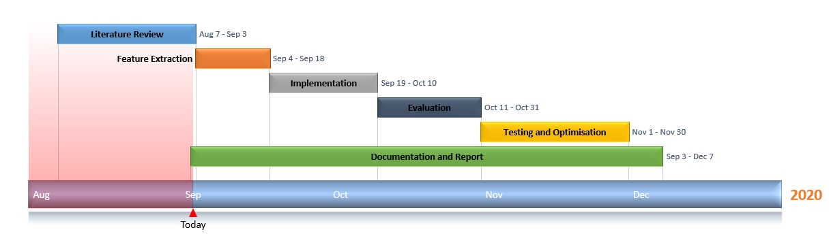
Project Timeline (tentative)
03/09/2020

Slide 22
References
World Health Organisation, Novel Coronavirus – China 2020, (2020). https://www.who.int/csr/don/12-january-2020-novel-coronavirus-china/en/. [1]
Zhao, Jinyu & Zhang, Yichen & He, Xuehai & Xie, Pengtao. (2020). COVID-CT-Dataset: A CT Scan Dataset about COVID-19. [2]
Brunese, Luca, et al. "Explainable deep learning for pulmonary disease and coronavirus COVID-19 detection from X-rays." Computer Methods and Programs in Biomedicine 196 (2020): 105608. [3]
Neuman, Mark I., et al. "Variability in the interpretation of chest radiographs for the diagnosis of pneumonia in children." Journal of hospital medicine 7.4 (2012): 294-298. [4]
03/09/2020

Slide 23
References
Wang, Linda. "A Tailored Deep Convolutional Neural Network Design for Detection of COVID-19 Cases from Chest X-Ray Images." arXiv preprint arXiv:2003.09871 (2020). []
Wang, Shuai & Kang, Bo & Ma, Jinlu & Zeng, Xianjun & Xiao, Mingming & Guo, Jia & Cai, Mengjiao & Yang, Jingyi & Li, Yaodong & Meng, Xiangfei & Xu, Bo. (2020). A deep learning algorithm using CT images to screen for Corona Virus Disease (COVID-19). 10.1101/2020.02.14.20023028. [5]
Zhang, Jianpeng & Xie, Yutong & Liao, Zhibin & Pang, Guansong & Verjans, Johan & Li, Wenxin & Sun, Zongji & He, Jian & Li, Yi & Shen, Chunhua & Xia, Yong. (2020). Viral Pneumonia Screening on Chest X-ray Images Using Confidence-Aware Anomaly Detection.
03/09/2020

Slide 24
References
Wu, Yu-Huan, et al. "JCS: An explainable COVID-19 diagnosis system by joint classification and segmentation." arXiv preprint arXiv:2004.07054 (2020).
Kassani, Sara Hosseinzadeh, et al. "Automatic Detection of Coronavirus Disease (COVID-19) in X-ray and CT Images: A Machine Learning-Based Approach." arXiv preprint arXiv:2004.10641 (2020).
Chatterjee, Soumick, et al. "Exploration of Interpretability Techniques for Deep COVID-19 Classification using Chest X-ray Images." arXiv preprint arXiv:2006.02570 (2020).
Ahsan, Md Manjurul, et al. "Study of Different Deep Learning Approach with Explainable AI for Screening Patients with COVID-19 Symptoms: Using CT Scan and Chest X-ray Image Dataset." arXiv preprint arXiv:2007.12525 (2020).
Chen, Yuanfang, et al. "An Interpretable Machine Learning Framework for Accurate Severe vs Non-severe COVID-19 Clinical Type Classification." medRxiv (2020).
03/09/2020

Slide 25
References
Zokaeinikoo, Maryam, et al. "AIDCOV: An Interpretable Artificial Intelligence Model for Detection of COVID-19 from Chest Radiography Images." medRxiv (2020).
Kumar, Gaurav, and Pradeep Kumar Bhatia. "A detailed review of feature extraction in image processing systems." 2014 Fourth international conference on advanced computing & communication technologies. IEEE, 2014.
Hong, Zi-Quan. "Algebraic feature extraction of image for recognition." Pattern recognition 24.3 (1991): 211-219.
Apostolopoulos, Ioannis D., Sokratis I. Aznaouridis, and Mpesiana A. Tzani. "Extracting possibly representative COVID-19 Biomarkers from X-Ray images with Deep Learning approach and image data related to Pulmonary Diseases." Journal of Medical and Biological Engineering (2020): 1.
Cozzi, Diletta et al. “Chest X-ray in new Coronavirus Disease 2019 (COVID-19) infection: findings and correlation with clinical outcome.” La Radiologia medica vol. 125,8 (2020): 730-737. doi:10.1007/s11547-020-01232-9
03/09/2020

Slide 26
References
Cleverley, Joanne & Piper, James & Jones, Melvyn. (2020). The role of chest radiography in confirming covid-19 pneumonia. BMJ. 370. m2426. 10.1136/bmj.m2426.
Getzi, Irene & Durairaj, D. & Raj, V. (2018). Efficient Image Retrieval approach for Large-scale Chest X Ray data using Hand-Crafted Features and Machine Learning Algorithms. International Journal of Computer Sciences and Engineering. 6. 890-896. 10.26438/ijcse/v6i11.890896.
Hasan, Ali & Al-Jawad, Mohammed & Jalab, Hamid & Shaiba, Hadil & Ibrahim, Rabha & Shamasneh, Alaa. (2020). Classification of Covid-19 Coronavirus, Pneumonia and Healthy Lungs in CT Scans Using Q-Deformed Entropy and Deep Learning Features. Entropy. 22. 517. 10.3390/e22050517.
Tsiknakis, Nikos & Trivizakis, Eleftherios & Vassalou, Evangelia & Papadakis, Georgios & Spandidos, Demetrios & Tsatsakis, Aristidis & Sánchez‑García, Jose & López‑González, Rafael & Papanikolaou, Nikolaos & Karantanas, Apostolos & Marias, Kostas. (2020). Interpretable artificial intelligence framework for COVID‑19 screening on chest X‑rays. Experimental and therapeutic medicine. 20. 10.3892/etm.2020.8797.
03/09/2020

Slide 27
References
Hansell, David & Bankier, Alexander & Macmahon, Heber & Mcloud, Theresa & Müller, Nestor & Remy, Jacques. (2008). Fleischner Society: Glossary of terms for thoracic imaging. Radiology. 246. 697-722. 10.1148/radiol.2462070712.
Durrani, Misbah & Haq, Inam & Kalsoom, Ume & Yousaf, Anum. (2020). Chest X-rays findings in COVID 19 patients at a University Teaching Hospital - A descriptive study. Pakistan Journal of Medical Sciences. 36. 10.12669/pjms.36.COVID19-S4.2778.
Nour, Majid & Cömert, Zafer & Polat, Kemal. (2020). A Novel Medical Diagnosis model for COVID-19 infection detection based on Deep Features and Bayesian Optimization. Applied Soft Computing. 106580. 10.1016/j.asoc.2020.106580.
Sethy, Prabira & Santi, Kumari & Behera, & Kumar, Pradyumna & Biswas, Preesat. (2020). Detection of coronavirus Disease (COVID-19) based on Deep Features and Support Vector Machine. 643-651. 10.33889/IJMEMS.2020.5.4.052.
03/09/2020

Slide 28
References
Toussie, Danielle & Voutsinas, Nicholas & Finkelstein, Mark & Cedillo, Mario & Manna, Sayan & Maron, Samuel & Jacobi, Adam & Chung, Michael & Bernheim, Adam & Eber, Corey & Concepcion, Jose & Fayad, Zahi & Gupta, Yogesh. (2020). Clinical and Chest Radiography Features Determine Patient Outcomes In Young and Middle Age Adults with COVID-19. Radiology. 201754. 10.1148/radiol.2020201754.
Ye, Wenjing & Gu, Wen & Guo, Xuejun & yi, Ping & Meng, Yishuang & Han, Fengfeng & Yu, Lingwei & Chen, Yi & Zhang, Guorui & Wang, Xueting. (2019). Detection of pulmonary ground-glass opacity based on deep learning computer artificial intelligence. BioMedical Engineering OnLine. 18. 10.1186/s12938-019-0627-4.
Santosh, K.C.. (2020). AI-Driven Tools for Coronavirus Outbreak: Need of Active Learning and Cross-Population Train/Test Models on Multitudinal/Multimodal Data. Journal of Medical Systems. 44. 10.1007/s10916-020-01562-1.
Zare, Mohammad Reza & Alebiosu, David & Lee, Sheng. (2018). Comparison of Handcrafted Features and Deep Learning in Classification of Medical X-ray Images. 1-5. 10.1109/INFRKM.2018.8464688.
03/09/2020

Slide 29
References
Ilovar, Miha & Šajn, Luka. (2011). Analysis of radiograph and detection of cardiomegaly.. 859-863.
Cohen, Joseph & Hashir, Mohammad & Brooks, Rupert & Bertrand, Hadrien. (2020). On the limits of cross-domain generalization in automated X-ray prediction.
Candemir, Sema & Rajaraman, Sivaramakrishnan & Antani, Sameer & Thoma, George. (2018). Deep Learning for Grading Cardiomegaly Severity in Chest X-Rays: An Investigation. 10.1109/LSC.2018.8572113.
Miranda Pereira, Rodolfo & Bertolini, Diego & Teixeira, Lucas & Silla, Jr & Costa, Yandre. (2020). COVID-19 identification in chest X-ray images on flat and hierarchical classification scenarios.
Zhang, Jianpeng, et al. "Viral pneumonia screening on chest X-ray images using confidence-aware anomaly detection." arXiv: 2003.12338 (2020).
03/09/2020

Slide 30
Thank You!
Questions?
03/09/2020

